Slide 1

Firma convenzione
Politecnico di Milano e Veneranda Fabbrica del Duomo di Milano
CNN-based early classification of rotating machinery fault diagnosis
Daoguang Yang, Hamid Reza Karimi and Kangkang Sun
Department of Mechanical Engineering, Politecnico di Milano
Milano, 20156, Italy
July 15, 2021
Aula Magna – Rettorato
Mercoledì 27 maggio 2015

Slide 2
Overview
Background
Proposed model
Rotating machinery fault dataset
Experiment results
Conclusion
Reference

Slide 3
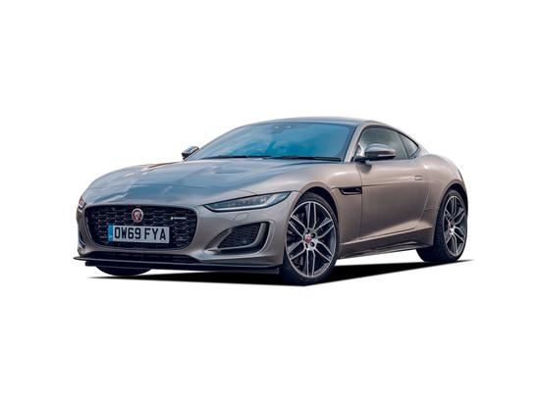
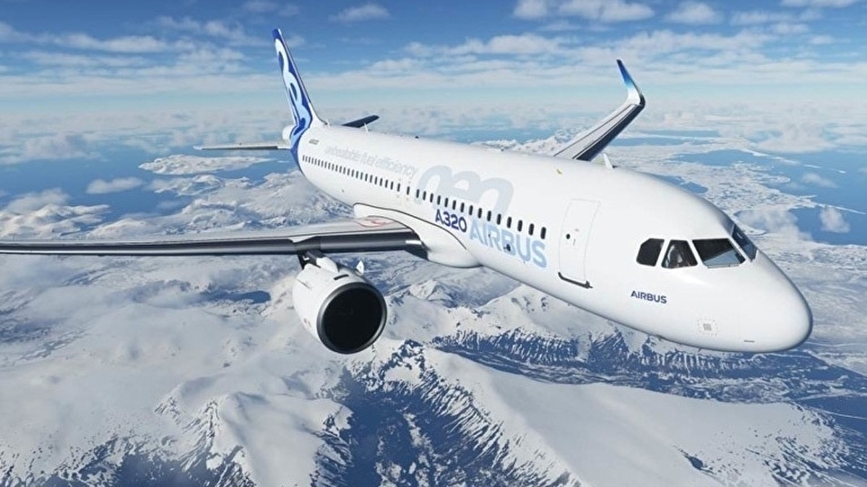
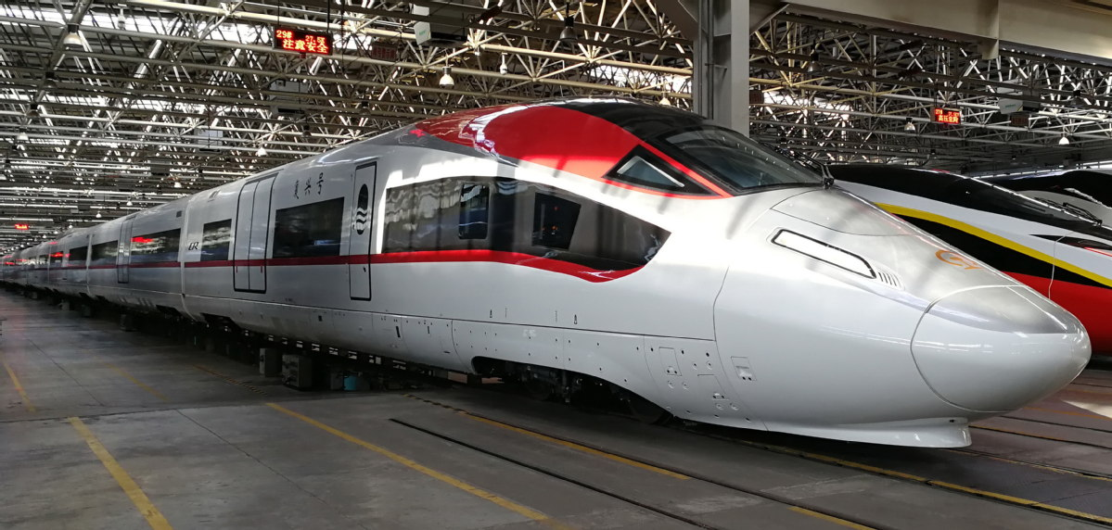
Backgound
With the emergence of the Industry 4.0, it is important to detect the fault type in the rotating machine as early as possible. Such as the rotating machinery in plane, vehicles.
Fig.1 Plane [1]
Fig.2 Vehicle [2]
Fig.3 High-speed train [3]
In addition, it is difficult to collect enough data of the rotating machinery fault. Hence, it is interesting to develop an Early Classification Model to deal with rotating machinery fault diagnosis.

Slide 4
Backgound
Traditional Classification Model
Traditional rotating machinery fault diagnosis approaches use all the data points to classify the fault type.
Early Classification Model
Earliness: The number of data points, that are used in the classification, specifies how early an incoming time series is classified.
Accuracy: A input data can be classified as accurately as possible if a classifier uses all the data points, but such classifier does not provide any earliness and therefore not suitable in the Industry 4.0.

Slide 5
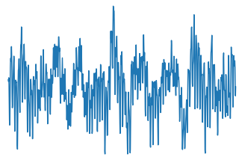
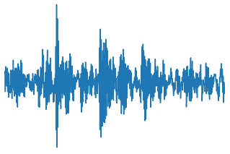
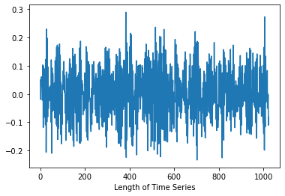
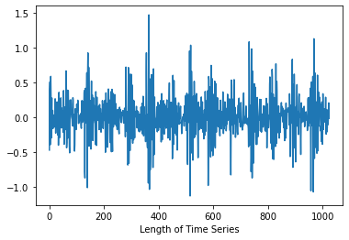
Backgound
Traditional Classification Framework:
Train
Intelligence Classifier
Fault type
Test
Full length data points
Same length data points

Slide 6
Backgound
Early Classification Framework:
Train
Intelligence Classifier
Fault type
Test
Full length data points
Partial data points

Slide 7
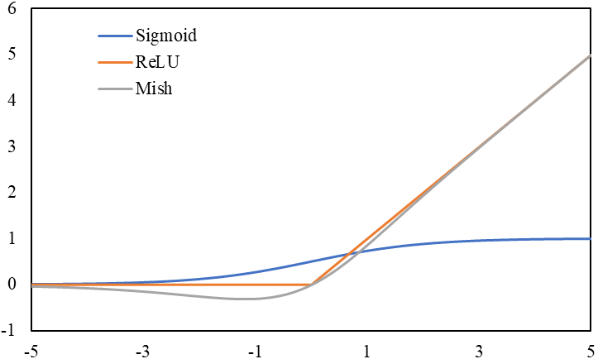
The proposed model
Firstly, in order to improve the feature selection ability of the traditional Convolutional Neural Networks, we used the Mish activation function[4], and the wide-kernel in the first convolutional layer. The Enhancement Convolutional Neural Networks.
The Mish activation function is defined as:
The ReLU activation function is defined as:
The sigmoid activation function is defined as:

Slide 8
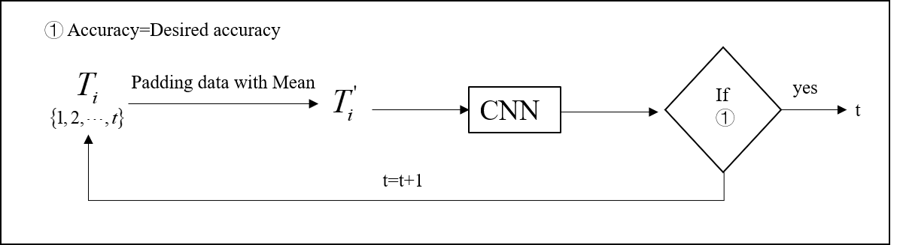
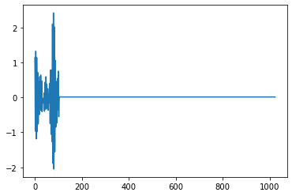
The proposed model
Testing Phase:
Padding data with Mean

Slide 9
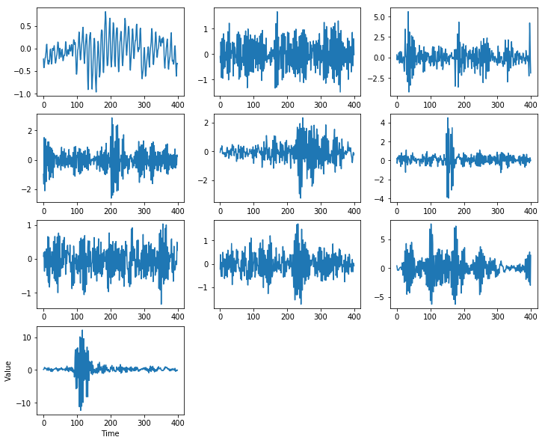
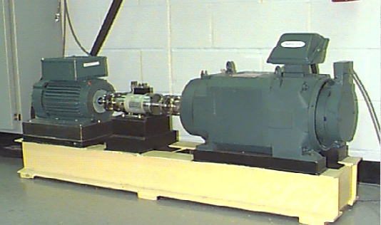
Rotating machinary fault dataset
CWRU bearing dataset
Case Western Reserve University (CWRU) Bearing Fault Dataset: CWRU bearing dataset is made up of nine fault categories and one normal condition. The nine types of faults are divided into three main types, which is the inner raceway fault, the outer raceway fault and the ball fault. There are three fault diameters for each fault type, which are 0.007 inches, 0.014 inches and 0.021 inches.
Fig 6. CWRU bearing test rig[5]
Fig 7. CWRU bearing fault waveform

Slide 10
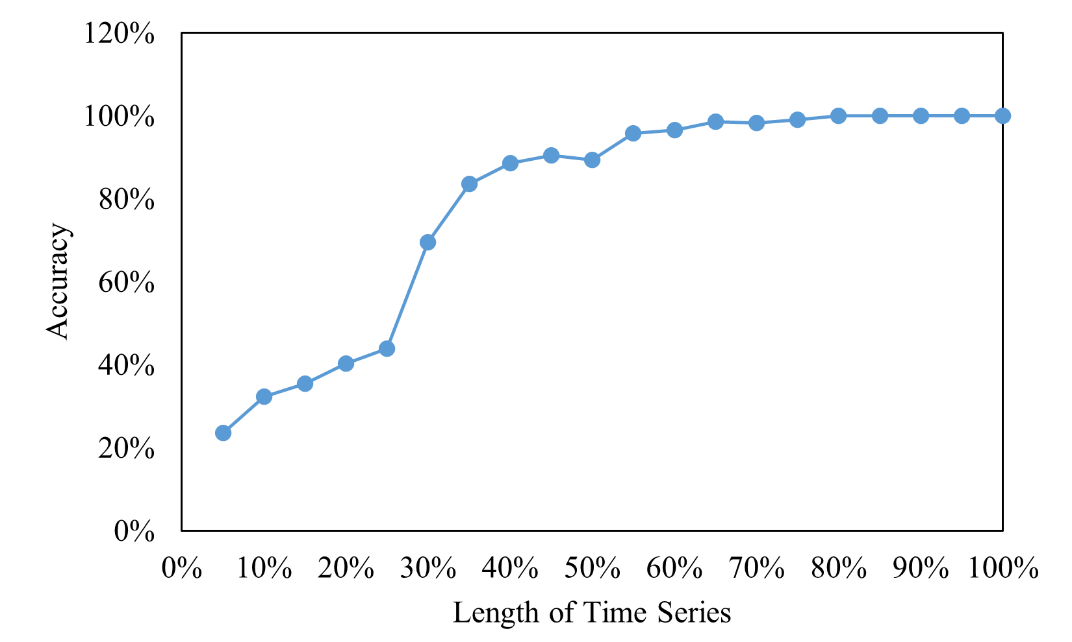
Experiment result
Firstly, it is necessary to describe the tradeoff between the accuracy and earliness based on the proposed framework.

Slide 11
Experiment result
Table 1. Comparison of the proposed method with traditional CNN on accuracy and earliness
 | Desired accuracy = 0.8 |  | Desired accuracy = 0.9
 | Accuracy(%) | Earliness(%) | Accuracy(%) | Earliness(%)
Traditional CNN | 83.57 | 63.57 | 90.43 | 49.33
Proposed | 80.86 | 69.45 | 91.86 | 64.30

Slide 12
Conclusion
1, We developed an early classification model based on the modified CNNs to identify the fault type as early as possible.
2, The proposed early classification model could identify the fault type precisely even if the length of the input time series is only half of the full length.
3, The results showed the proposed model outperformed the traditional CNNs.

Slide 13
Reference
[1] https://www.eurogamer.net/articles/2020-09-14-twitch-chat-managed-to-land-a-plane-in-microsoft-flight-sim
[2] http://product.auto.163.com/series/16793.html
[3] https://www.railtech.com/innovation/2021/01/05/china-presents-freight-train-to-break-speed-record-with-350-kmph/
[4] Misra, Diganta. "Mish: A self regularized non-monotonic activation function." arXiv preprint arXiv:1908.08681 (2019).
[5] Case Western Reserve University Bearing Data Center. [Online]. Available: http://csegroups.case.edu/bearingdatacenter/pages/welcomecase-western-reserve-university-bearing-data-center-website

Slide 14
Firma convenzione
Politecnico di Milano e Veneranda Fabbrica del Duomo di Milano
Thanks for your attention.
Aula Magna – Rettorato
Mercoledì 27 maggio 2015

